Slide 1
Handling Missing Data in R
April 29, 2024
Rahul Patel | Sally Xie

Slide 2


What is missing data?
Occurs when no data is stored for a variable in an observation
Can be represented as NA, nan, 99,-99, ., "", etc.
Technical
Human
Experimenter, Participant

Slide 3



What are the types of missing data?
Type | Missing Completely at Random (MCAR) | Missing at Random (MAR) | Missing Not at Random (MNAR)
Description | No systematic relationship between missing data and other values | Systematic relationship between missing data and other observed values | Systematic relationship between missing data and unobserved values
Example | Data entry errors when inputting data | Psychology students researching non-EDI topics seldom complete the EDI survey | People who are less satisfied with their jobs do not complete employee experience survey
Notes:
For this workshop we focus on addressing handling missing data that is of the MAR and MCAR type
Problematic to have MAR data as it can lead to biased data , therefore important to address it

Slide 4
Dataset overview: Job Satisfaction
jsat: job satisfaction; 7-point Likert type scale; strongly disagree-strongly agree
gender: Gender (1 = Male; 2 = Gender minority)
age: Age
race: Race (1 = Native; 2 = Middle-Eastern; 3 = East Asian; 4 = South Asian; 5 = Southeast Asian; 6 = Black; 7 = Latinx; 8 = Pacific Islander; 9 = White)
edu: Education (1 = Some high school; 2 = Completed high school; 3 = Apprenticeship/trades; 4 = Some college/university; 5 = Completed college/university; 6 = Some post-graduate education; 7 = Completed post-graduate education)

Slide 5
What is imputation?
Substituting missing values with different values
Multiple imputation is a general framework that generates several imputed versions of the data by replacing the missing values with plausible data values
These plausible numbers are derived from distributions of and relationships among observed variables in the data set

Slide 6
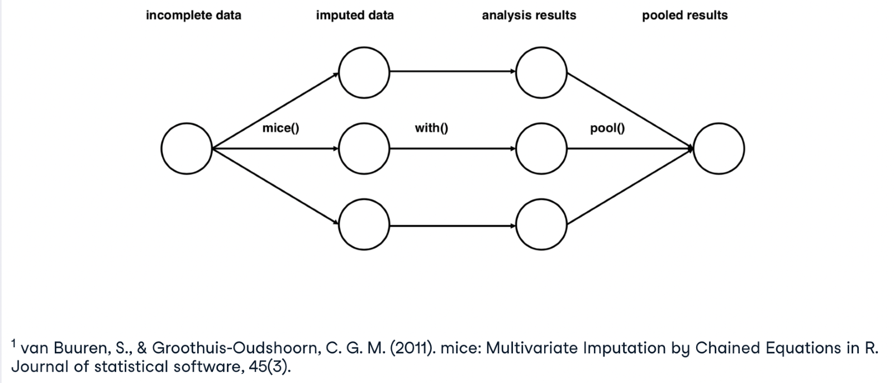
The MICE algorithm
Notes:
We are only focusing on the imputation, however you could also use it for analysis
Multiple imputation is a general framework that generates several imputed versions of the data by replacing the missing values by plausible data values. These plausible values are drawn from a distribution specifically modeled for each missing entry
For this workshop we are only going over the mice function

Slide 7
MICE: pros & cons
Pros
Requires fewer replications than the bootstrap
Works for MAR and MCAR data
Cons
Only works with selected imputation methods
Requires more tuning effort (model selection, choosing predictors)

Slide 8
What do we do from here?
Packages
Visualization
Multiple imputation with mice
Assessing imputation

Slide 9
Conclusions and Considerations
Ethical considerations for imputing social identifiers:
01
Context of your research
Which communities are directly impacted by your research?
Incorporate open science practices into multiple imputation so that others may replicate the work
02
Multiple imputation is less biased and more representative than other methods like deletion (Woods et al., 2023)
03
In our example we only imputed scale scores, however, imputing item scores is also possible
04
Notes:
First, multiple imputation does not simply “assign” a social identifier to an individual with missing data. It creates a probability distribution of multiple social identifiers based on the rest of the information known about an individual.
Second, multiply imputed data do not create findings about any specific individual who has had their data imputed; instead, conclusions are drawn about an aggregated population from the models containing individual data.
Limitation of only calculating a scale score as opposed to item score, still possible to do for just missing values

